Slide 1

Programming Attiny10 using Arduino Uno

Slide 2
Required Components
These are the following components that are required to Upload the code to Attiny10. 1. Attiny10 2. Arduino Uno 3. Some wires 4. 220Ohm resistors-4 5. Arduino IDE 1.8.9

Slide 3
Procedure
To proceed with the process first of all There are two versions of attiny10 microcontroller. If you have a dual in line package which can be mounted into PCB, you can directly use bread board.
If you have a small smd version then solder that controller onto your custom board or 6 pin sot23 pcb board to use microcontroller.
In my case I have used sot24 pcb board. And connected it to pcb to program.

Slide 4
Procedure
Now download Arduino IDE 1.8.9 and also download the zip file from following link. https://github.com/kimio-kosaka/avrboy/releases/download/v1.0.1/ATtiny4_5_9_10_20_40Programmer_2.zip
This method only works on v1.8.9 and also we have to turn arduino uno as a programmer. The zip file contains that code.

Slide 5
Procedure
Now open Install Arduino IDE that has been downloaded and install new board i.e., bitduino 10a-TPI.
You can do this by updating board manager URL within the preferences option with this following link. https://kimio-kosaka.github.io/bitDuino10-arduinoTPI/package_bitDuino10-arduinoTPI_index.json
After inserting this link click ok and search for bitduino in boards manager option.

Slide 6
Procedure
Install new board and select the newly installed board.
Now connect Arduino Uno and upload the Arduino code from the zip file to turn it into programmer.
And now get all the components that are required to this proceed with this process. Like resistors, wires and mainly attiny10 microcontroller.

Slide 7
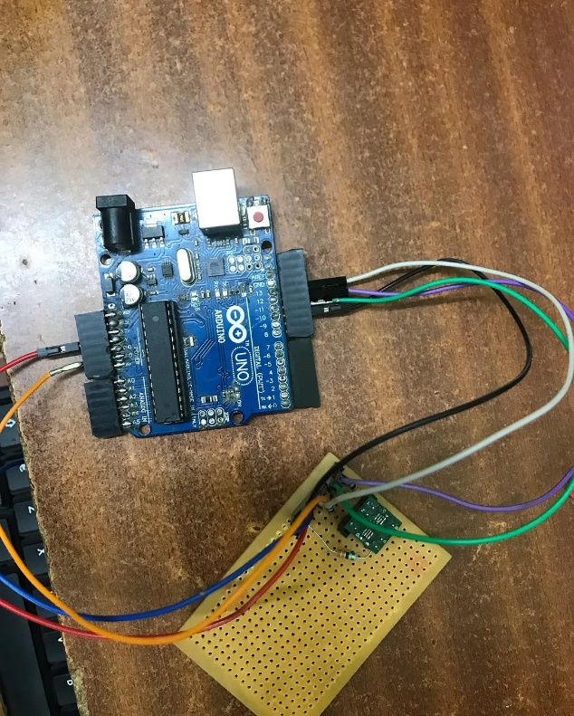
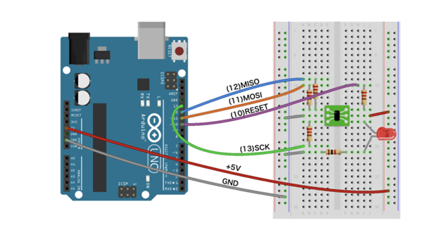
Procedure
I have soldered the resistors and made connections as per the circuit diagram that has shown below.

Slide 8
Procedure
And now change the board from board manager as attiny10 bitduino and select the port which is connected to the Arduino.
Its time to write some code for attiny10 microcontroller. I have gone with the basic blink code.
After compilation process is done, check all connections before uploading the code.
Upload the code to attiny10. It might take few seconds to do it. If it is failed try replicate the same procedure. And if you are doing everything right. Then it might be your computer or software.

Slide 9
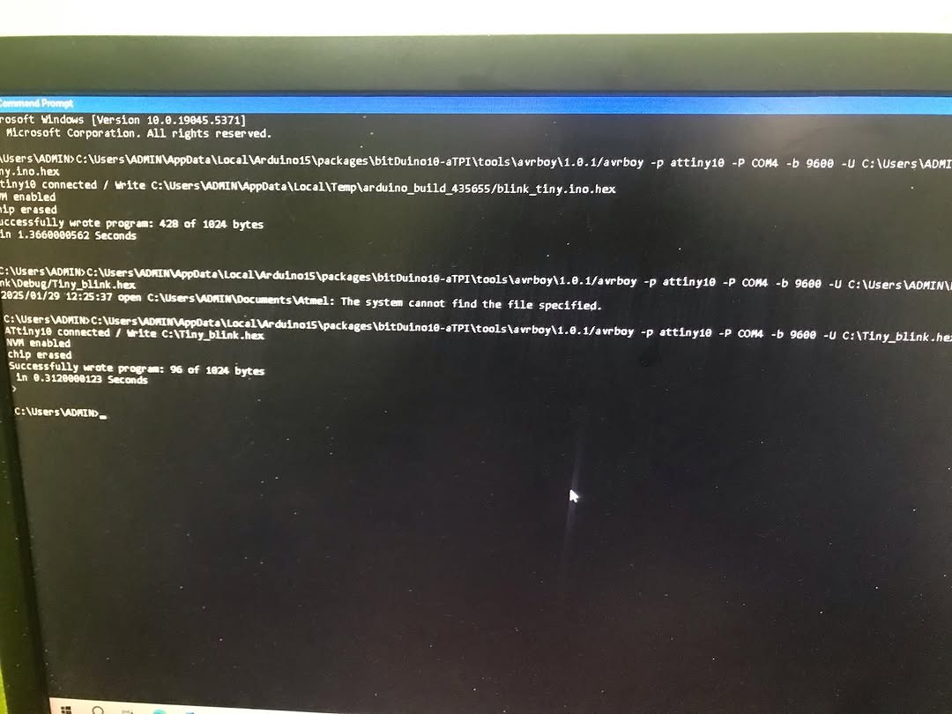
Procedure
I have failed to upload with my laptop. But, It works with my PC.

Slide 10
Procedure
You might have noticed that it occupies less memory as compared to first code. Because the second code has been written in atmel studio.
And the code is optimized for attiny10 whereas Arduino IDE is taking half of controller memory.
And you can even optimize the code in atmel studio by avoiding huge libraries.

Slide 11
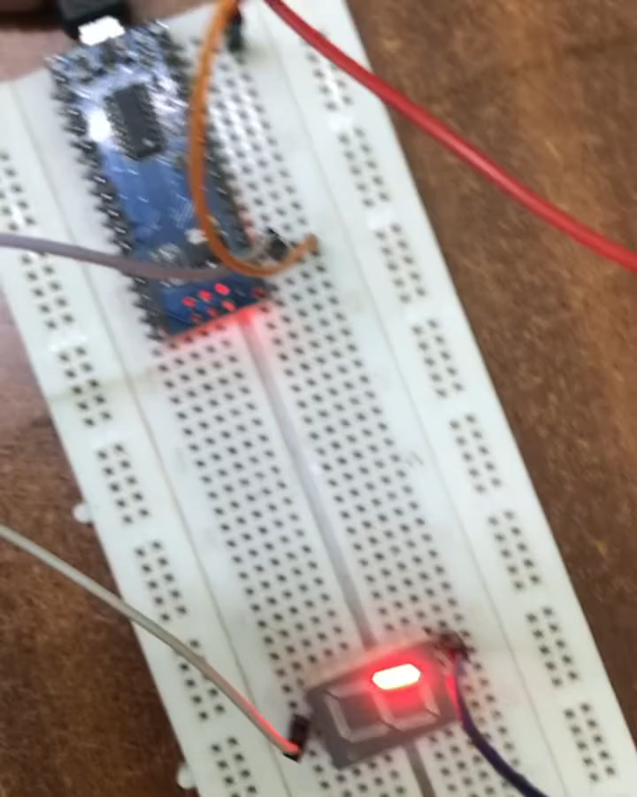
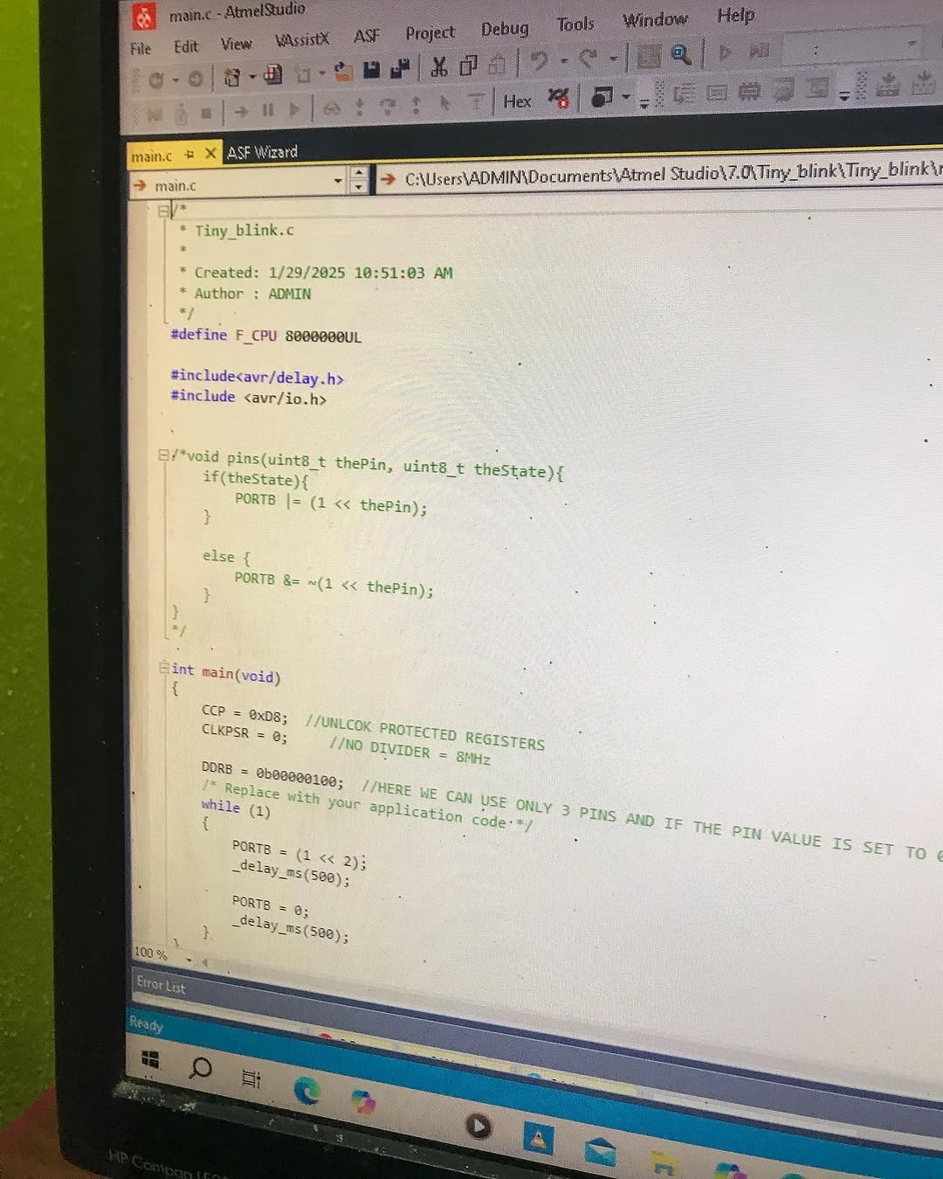
Results

Slide 12
References
https://kimio-kosaka.github.io/bitDuino10-arduinoTPI/
https://youtu.be/71K1L3ZJR8g?si=VOe56Yxncl8lmcqi
You can get all files from my github https://github.com/kudurlagoutham/attiny10-programming

